Slide 1
SUBNETTING

Slide 2
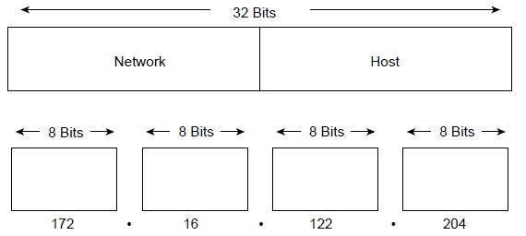
IP Address Format
The 32-bit IP address is grouped eight bits at a time, separated by dots, and represented in decimal format.
Each bit in the octet has a binary weight (128, 64, 32,16, 8, 4, 2, 1).
The minimum value for an octet is 0, and the maximum value for an octet is 255.

Slide 3
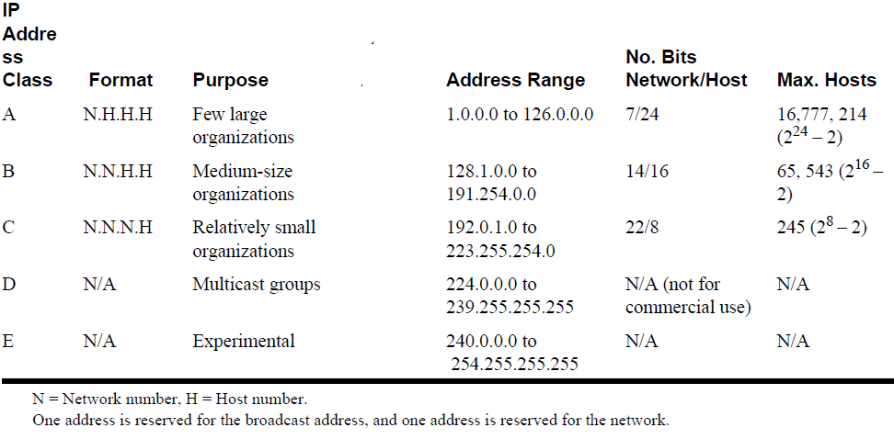
IP addressing supports five different address classes: A, B,C, D, and E. Only classes A, B, and C are available for commercial use
21/8
254

Slide 4
IP networks can be divided into smaller networks called subnetworks (or subnets).
FOR EXAMPLE
172.16.1.0, 172.16.2.0, 172.16.3.0, and 172.16.4.0 are all subnets within network 171.16.0.0. (All 0s in the host portion of an address specifies the entire network.)

Slide 5
Packet Tracer Tutorial

Slide 6
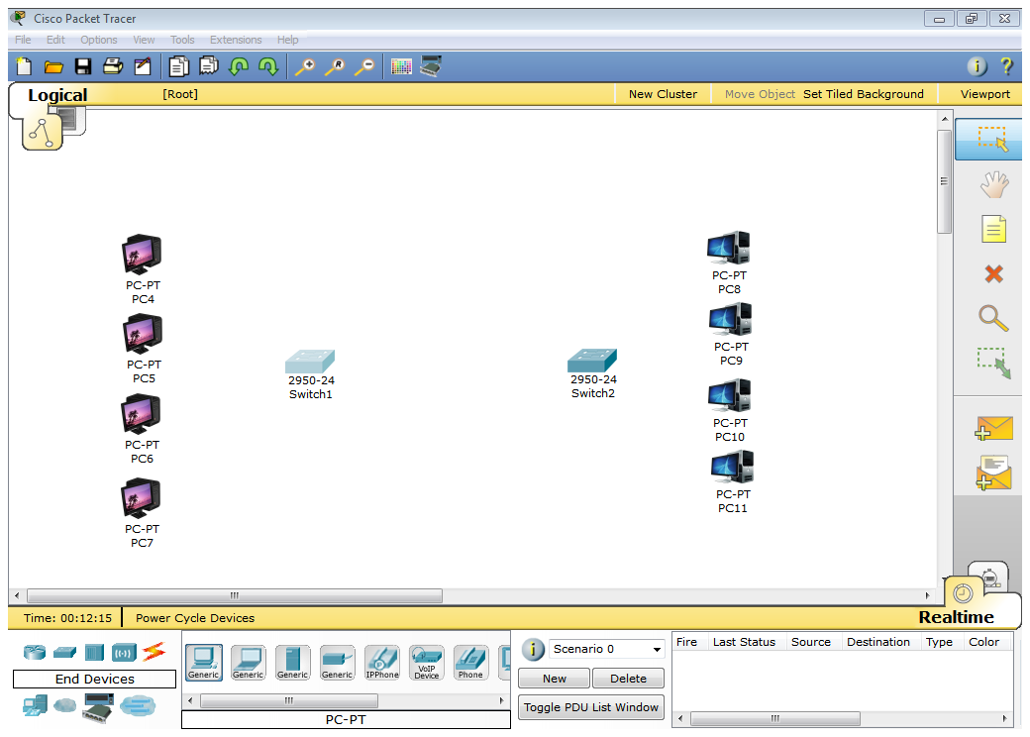
Take 4 pc’s each side that will be connected by 2 switches 2950-24

Slide 7
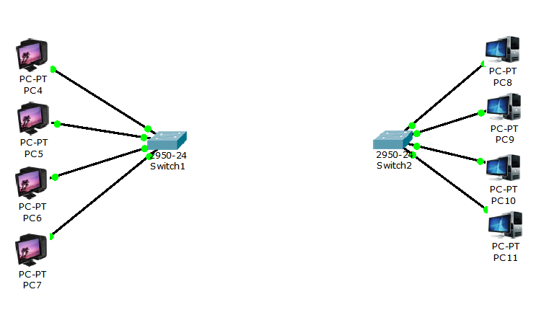
Connect All of them With copper straight through cable

Slide 8
Assigning IP
10.0.0.1 | To | 10.255.255.254
172.16.0.1 | To | 172.31.255.254
192.168.0.1 | To | 192.168.255.254
If 2 computers want to communicate in a network they must have same type of address

Slide 9
Assign ip To pc’s in 1st network

Slide 10
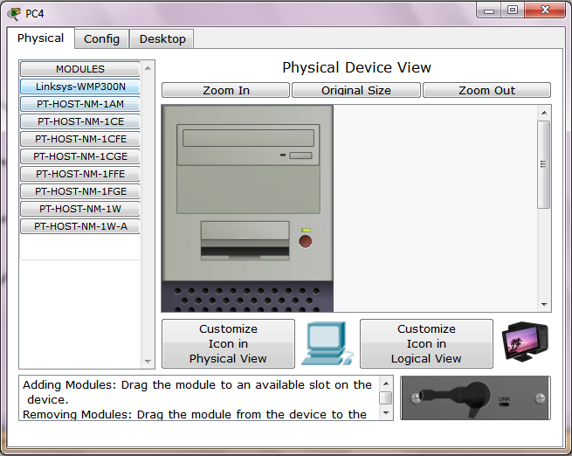
Double click on Pc

Slide 11
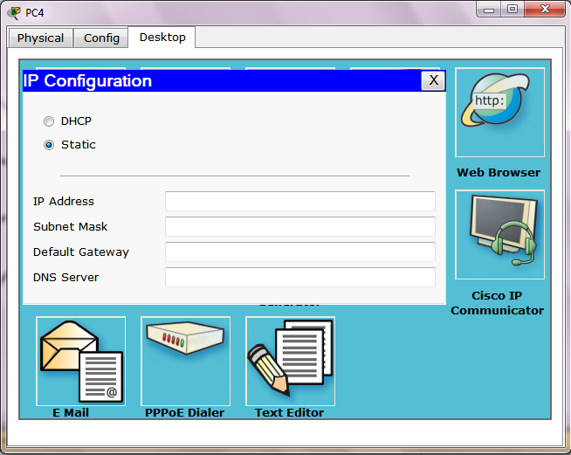
Goto desktop tab and click ip configuration

Slide 12
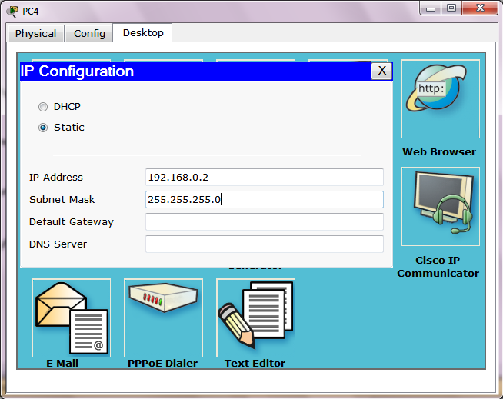
Insert ip of the 1st pc subnet will automatically generate and leave the gateway right now

Slide 13
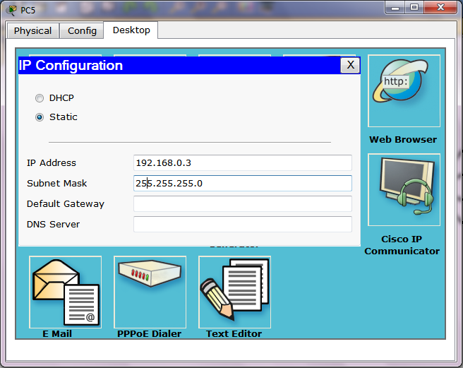
Ip of 2nd pc

Slide 14

IP of 3rd PC

Slide 15

IP of 4th PC

Slide 16
Remember i have inserted ip’s in all computer of same class 192.168.0._ “you need to limit yourself to one class of private addresses, if you want to computers to talk with each other” (joe-habraken)

Slide 17
Assign IP’s to the PC’s In the 2nd network like 192.168.10.2 192.168.10.3 192.168.10.4 192.168.10.5

Slide 18
Connecting Network With One Router

Slide 19
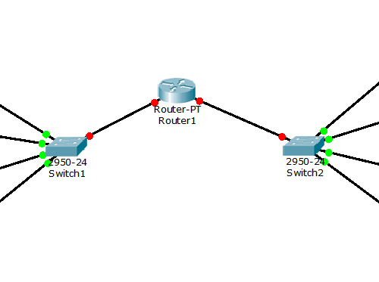
Connect One Generic Router Connect It With Swith 0 from fast ethernet 0/0, Connect It With Swith 1 from fast ethernet 1/0 With Copper straight through cabble

Slide 20
Configuring router

Slide 21
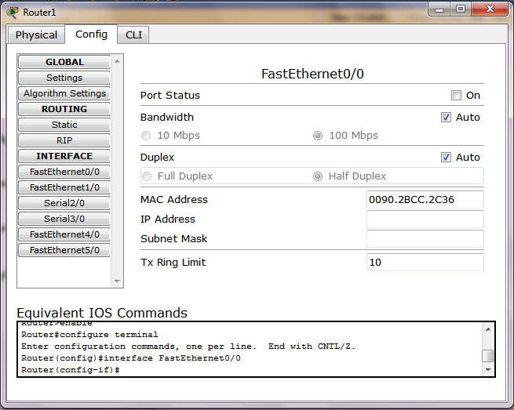
Router connectted with the network one from fast ethernet 0/0 1) double click on router 2) goto config tab 3) click fast ethernet 0/0

Slide 22
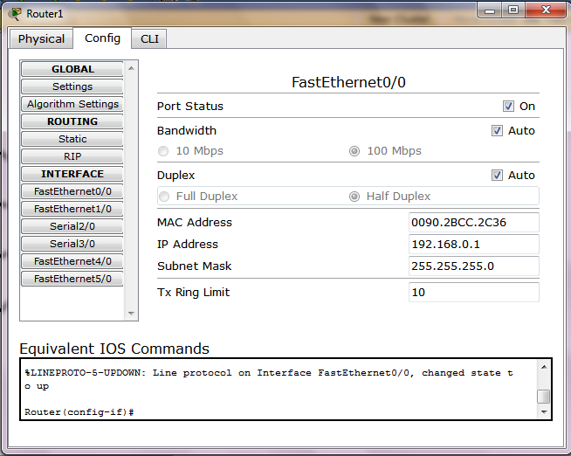
Insert ip of the class as the network 1 have So i inserts the ip 192.168.0.1 subnet will automatically generate make sue port status on

Slide 23
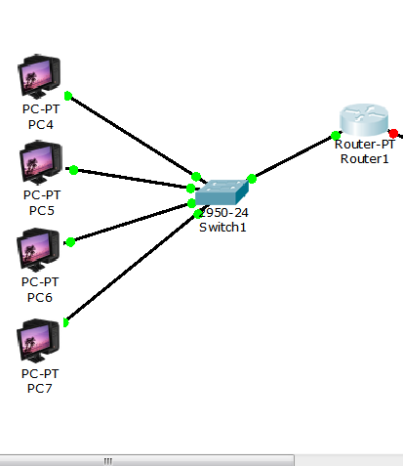
Router is configured with network 1

Slide 24
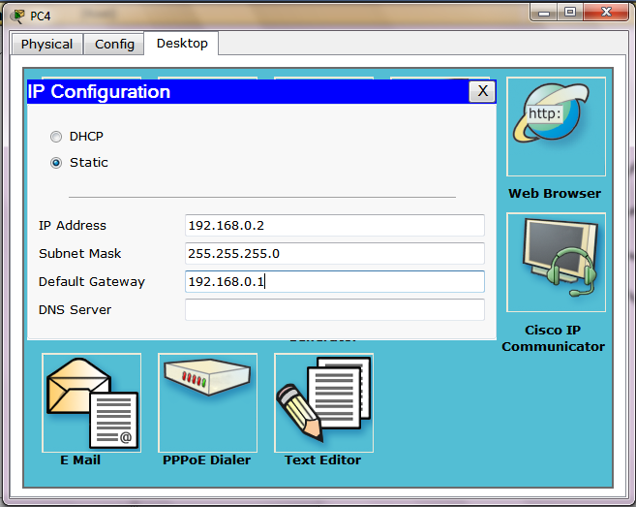
Insert getway of all pc’s in network one , the ip of router through which they are connected 192.168.0.1

Slide 25
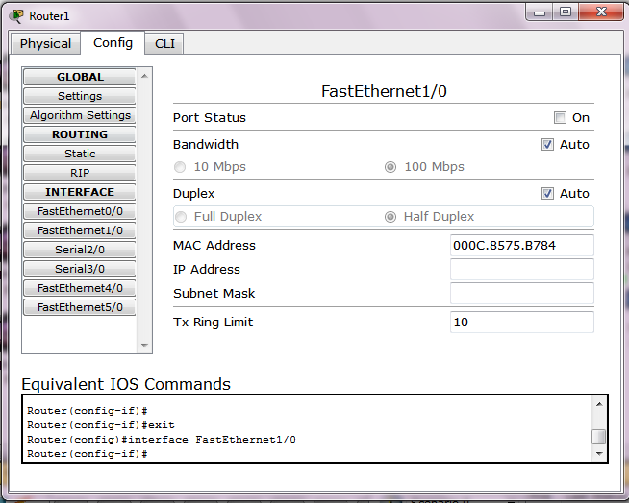
Router connectted with the network 2 from fast ethernet 1/0 1) double click on router 2) goto config tab 3) click fast ethernet 1/0

Slide 26
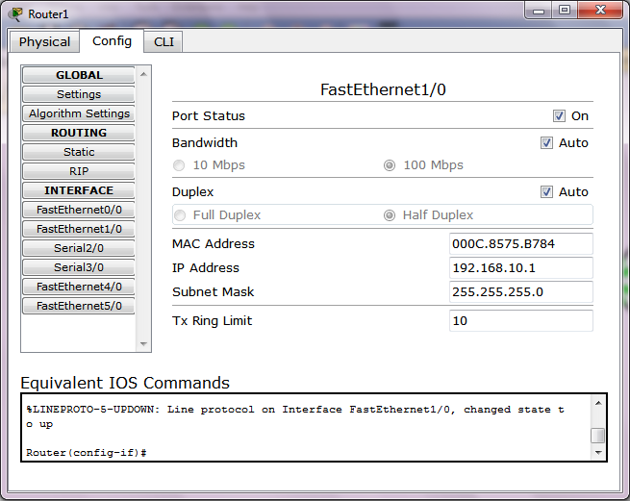
Insert ip of the class as the network 2 have So i inserts the ip 192.168.10.1 subnet will automatically generate make sue port status on

Slide 27
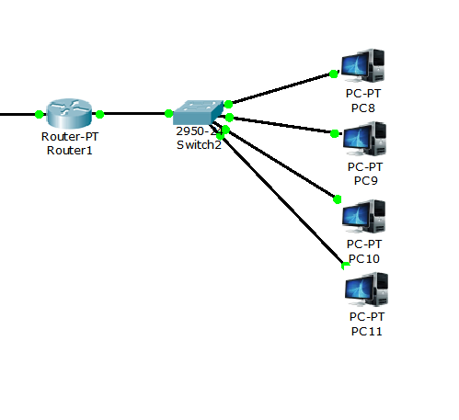
Router is configured with network 1

Slide 28
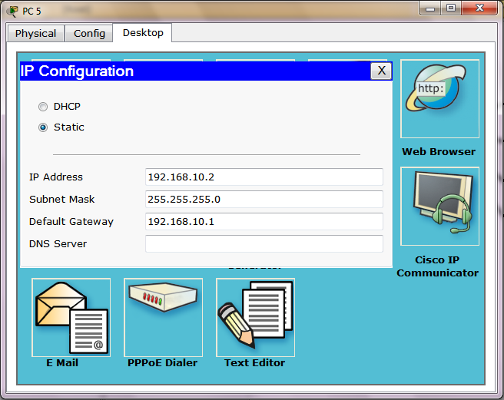
Insert getway of all pc’s in network one , the ip of router through which they are connected 192.168.0.1

Slide 29
Add Router Information Protocol Double click on router Click config Tab Click rip
1st network is
192.168.0.1
192.168.0.2
192.168.0.3
192.168.0.4
192.168.0.4
So add the rip address 192.168.0.0
And click add
Add the rip address 192.168.10.0
For the 2nd network

Slide 30
Pinging

Slide 31
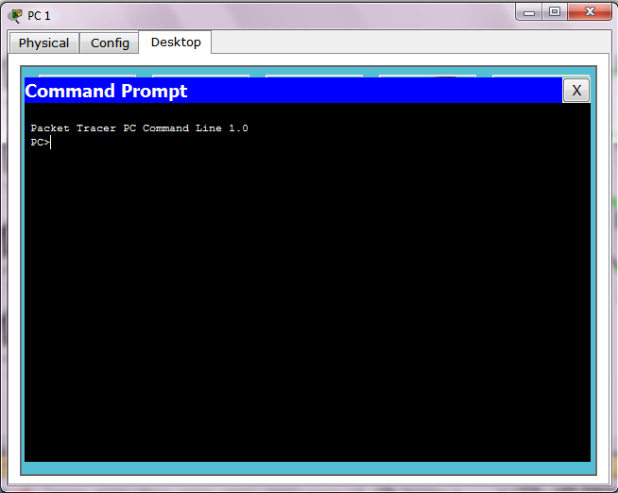
Goto the command promt of any pc

Slide 32
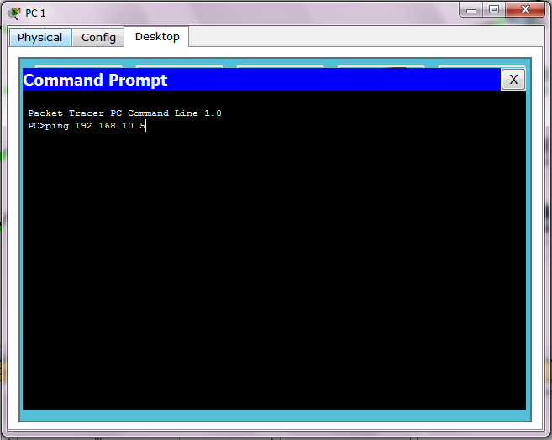
Ping any IP of the network

Slide 33
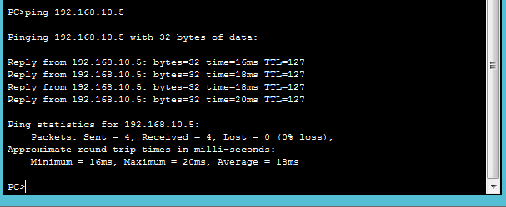
Now what you see is

Slide 34
Thank You

